Slide 1
The Business Analytics Model
Business Intelligence & Analytics

Slide 2
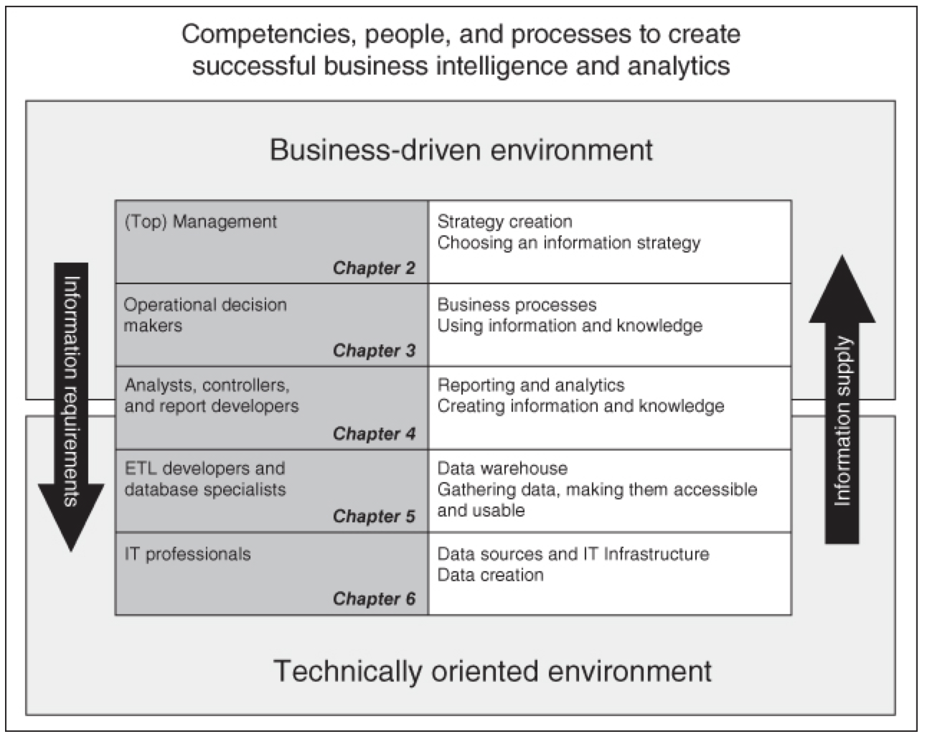

Slide 3
Failure not due to technology
It is particularly striking that 77% of respondents say that “business adoption” of big data and AI initiatives continues to represent a challenge for their organizations. This issue, and the low percentage of companies that have achieved data-driven organizations and cultures, suggests the need for a new focus. Respondents clearly say that technology isn’t the problem—people and (to a lesser extent) processes are.
Yet we would guess with high confidence that the great majority of spending on big data and AI goes for technology and its development. We hear little about initiatives devoted to changing human attitudes and behaviors around data. Unless the focus shifts to these types of activities, we are likely to see the same problem areas in the future that we’ve observed year after year in this survey. Let’s make the glass fuller.
-NVP Big Data and AI Executive Survey 2019

Slide 4
7 sure fire ways to fail at analytics
Jump in without knowing what you’re looking for
Build (and maintain) your own infrastructure
Be a data divider, not a data unifier
Eschew good data hygiene
Forgo executive sponsorship of analytics initiatives
Ignore middle- and lower-level managers
Lack the culture and skills to support good data analytics

Slide 5
7 sure fire ways to fail at analytics
Jump in without knowing what you’re looking for
“This idea behind data mining that you could have the system find out what's interesting in the data has led many companies astray over decades,” Davenport says
Forgo executive sponsorship of analytics initiatives
“The objective of analytics teams is to generate insights by connecting the data with a company’s tactical and strategic decisions,” Miglani says
Ignore middle- and lower-level managers
“Without the active involvement of mid- to lower-level managers, the information delivered by the analytics team often fails to actually help the management team do their job better each day,” says David Giannetto
Lack the culture and skills to support good data analytics
It will be hard to convince your business partners to make decisions on opaque algorithms. You will need to educate them first.

Slide 6
Strategy creation
Strategy = combination of all the decisions taken and actions performed to secure a competitive position in the market
Produces
Key Performance Indicators (KPIs) = used to measure degree of progress and success
Can be very high level at this stage of the model
Notes:
Here want to mention the task regarding OKRs. There are a few primary goal setting methodologies used in business today. at Domo we use OKRs so I’m going to include it in the course because of its simplicity and its potential impact on a business. This method can be used at the strategic level to specify clearly the company’s strategy and how that strategy will be achieved and measured. The probabilist in me wants to say that if you don’t have this level of strategic direction, success will happen at random. What I really mean by that is that your efforts will likely be wasted.

Slide 7
Business process and information use
KPIs inform the next level what is important to business leaders
Produces
Optimized processes that ensure KPIs reach specified levels
Notes:
Need to make sure KPIs produce the correct behaviors at this level.

Slide 8
Reporting and analytics processes
Business processes designed to meet Key Performance Indicators
Produces
Data collection, analytics strategies and potentially statistical models

Slide 9
Data warehouse
Data collection, analytics strategies and statistical models
Produces
Data collection technologies and data structures

Slide 10
Data sources: IT ops and development
Data collection technologies and data structures
Produces
Staff hired to create and maintain these technologies
Notes:
If this process is not followed, the wrong technologies and skill sets will be purchased and hired and will invalidate the entire effort.

Slide 11
Presented here as the basis of successful business analytics deployment and execution

Slide 12


